Slide 1
Kernel.NET Part 2 Advanced .NET Debugging with WinDbg
Steven M. Cohn
2013

Slide 2
PSR Workshop Series
The .NET Garbage Collector and Best Practices
A presentation of the GC and related best practices
Advanced .NET Debugging
A workshop on Windows debuggers, leaks, hangs, and crash dumps
.NET Profilers: Identifying Leaks and Spikes
A workshop on how to identify and fix issues using profilers
You are here!

Slide 3

How to use this presentation
Slides with this note icon in the upper-right corner have additional notes available below the slide
This presentation can be used either in a group workshop environment or for self-paced learning
Notes:
This space intentionally left blank.
You didn’t think you’d actually find real notes for this slide, did you?

Slide 4
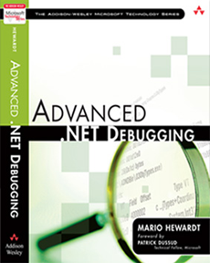
Workshop Goals
WinDbg basics and CLR internals
Debug scenarios, crash dumps, real-time debugging
Based on
Advanced .NET Debugging
Mario Hewardt
Notes:
http://www.amazon.com/Advanced-NET-Debugging-Mario-Hewardt/dp/0321578899

Slide 5

Why? Why? Whyyyyyy?
WinDbg…
Leaks, Hangs, Deadlocks
Crash dumps from the field
Quick analysis
Small footprint
Non-invasive option
Production environments
Notes:
Impact of diagnostic tools
(Least invasive to most invasive)
Least invasive to most invasive Environments
Production
Staging
Perf/scale test
Integration test
Functional test
Development
Least invasive to most invasive Tools
Application Logs
PerfMon
ADPlus
DebugDiag
WinDbg/CDB
MDbg
Visual Studio
Profilers

Slide 6
Screw Drivers and Glue
Debugging Tools are now part of Windows 8 SDK
Along with WinDbg, these may also be useful:
ADPlus – automates dumps, reacts to live system
CLR Profiler – Memory allocation profiler, GUI
DebugDiag – automate dumps, dump leak analysis
GFlags – edit advanced debugging settings
PerfMon – Windows performance monitor
Process Explorer – A better Task Explorer
Reflector – Assembly analyzer and disassembler
Notes:
ADPlus – part of Windows SDK (and debugging redistributables)
CLR Profiler - http://www.microsoft.com/en-us/download/details.aspx?id=16273
DebugDiag - http://www.microsoft.com/en-us/download/details.aspx?id=26798
GFlags – part of Windows SDK (and debugging redistributables)
PerfMon – part of Windows
Process Explorer - http://technet.microsoft.com/en-US/sysinternals/bb896653.aspx
Reflector – available on EDN Downloads

Slide 7

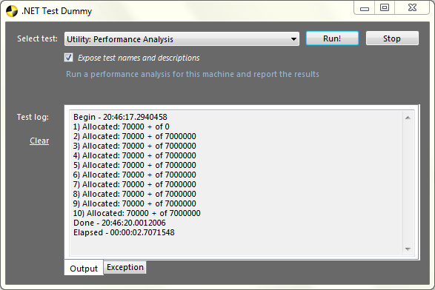
This Lab Includes…
A Visual Studio solution named CrashLab
Modules are demonstrated by CrashLab project
Each case study is a TestBase:ITest class

Slide 8
WinDbg 101

Slide 9

Hello WinDbg
WinDbg is a command-line driven utility.
Base commands are simple words such as g, lm, and ~
0:000> ~3s
0:000> g
Meta-commands begin with a period such as .load and .shell
0:003> .shell –ci “!dumpheap –stat” find “String”
Extension commands begin with ‘!’ such as !clrstack and !dumpheap
0:003> !dumpheap –stat –type String
The prompt indicates the target and the current thread index.

Slide 10
WinDbg Extensions
Basic command list can be extended through plug-in model. SOSEX and SOS (or PSSCOR) are for .NET specifically
WinDbg
ntsdexts
ext
sosex
uext
sos
exts
dbghelp

Slide 11
Setup
After installing the Debugging Tools as part of the Windows 8 SDK…
C:\Program Files (x86)\Windows Kits\8.0\Debuggers\x86\WinDbg.exe
C:\Program Files (x64)\Windows Kits\8.0\Debuggers\x64\WinDbg.exe
Run the correct one for your application!
SOS.dll comes with .NET, both 32-bit and 64-bit, for 2.0 and 4.0/4.5
Add SOSEX from the lab materials (or download)
Copy x32 DLL C:\Windows\Microsoft.NET\Framework\v4.0.30319
Copy x64 DLL C:\Windows\Microsoft.NET\Framework64\v4.0.30319
Optionally add PSSCOR4 – does NOT yet work with .NET 4.5!
- Enhanced version of SOS

Slide 12
Loading Extensions
.NET debugging will require both SOS and SOSEX
0:000> .loadby sosex clr
0:000> .loadby sos clr
As we’ll see soon, clr.dll must be loaded first
Use the .chain command to view all extensions
Extensions are searched in top-down order
0:000> .help - show meta-command help
0:000> !help - show most recently loaded extension help
0:000> !sos.help - show SOS command help
0:000> !sosex.help - show SOSEX command help (also !psscor4.help if loaded)

Slide 13
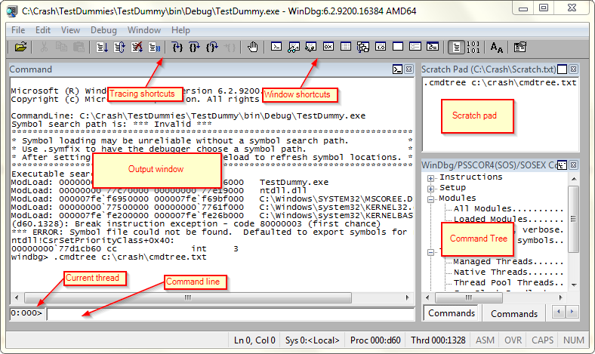
Custom is always better
Let’s take a stroll around the UI

Slide 14
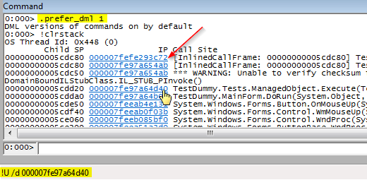
Enable DML
Debugger Markup Language is interpreted by the Output window by adding “hyperlinks” for known values.
To enable DML, use the .prefer_dml command
Hover over the link to see the command in the status bar
Click the link to execute the command
Notes:
There is more information in the dml.doc document located in the same folder as the WinDbg executable.

Slide 15
Cmd Tree and Scratch Pad
The.cmdtree [file] command (undocumented) loads a structured file of commands into the Command window
Double-click lines to execute the commands
No shortcut to run this command!
Place the file where it’s easily accessible (c:\ or path of WinDbg)
Lab materials includes the file cmdtree.txt
This file is also available on the UNIFI Wiki under Debuggers
The lab also includes a Scratch.txt file to associated with the Scratch Pad Window
Every time you open WinDbg, just copy/paste commands from this window for quick and easy setup!

Slide 16
Paths
WinDbg uses three paths: executable, symbols, and source. We need at least symbols to help us out!
0:000> .sympath
Symbol search path is: <empty>
Expanded Symbol search path is: <empty>
0:000> .sympath srv*c:\symbols*http://msdl.microsoft.com/download/symbols
Symbol search path is: srv*c:\symbols*http://msdl.microsoft.com/download/symbols
Expanded Symbol search path is: srv*c:\symbols*http://msdl.microsoft.com/download/symbols
0:000> .reload
Reloading current modules
.....
Symbols will be downloaded from the Microsoft server into the local symbol cache C:\symbols.
.reload is required to actually load the symbols after the path is set
Consider setting _NT_SYMBOL_PATH environment variable (see notes)
Notes:
Consider setting the _NT_SYMBOL_PATH environment variable; as a bonus many other applications can use this like Process Explorer, Process Monitor, etc.
In case of postmortem or remote debugging the situation can be complicated as one might not have the appropriate version and architecture of .NET Framework installed on his machine (especially with the arrival of arm devices running .NET) - using the Microsoft symbol server for loading the modules needed for debugging (especially mscordacwks.dll) is a recommendable way. Here are some setup steps for postmortem or remote debugging of managed code in windows debugger:
Set your symbol path to Microsoft symbol server (internal or external)
Set your execution image path to Microsoft symbol server
Make sure that the core CLR binary (mscorwks.dll or clr.dll) is loaded, reload it (with .reload /f) if it’s not
Reload CLR debugging related binaries by using ‘.cordll –ve –u –l’ command (-ve for verbose, –u for unload, –l for load)
Load the SOS module from the core CLR binary location (as you’d do that for live debugging)

Slide 17
CLR Internals

Slide 18
Startup and Loading the CLR
Run WinDbg, press Ctrl-E and open CrashLab.exe
Type the loaded modules command: lm
What do you notice? Try: .loadby sos clr
Did it work? Now try this: sxe ld:clrjit.dll; g
What happened? Now try: .loadby sos clr
Did it work? Examine app domains: !dumpdomain
Copy the domain info to the Scratch Pad window so we can compare it on the next slide…
Notes:
Notice that WinDbg immediate hits a breakpoint after loading CrashLab.exe.
The WinDbg engine injects this breakpoint it the executable just after the module is loaded.
The sxe ld:clrjit.dll; g command is actually two commands, separated with a semi-colon.
sxe ld:clrjit.dll – requests a breakpoint immediately after clr.dll is JITed
g – this is the debugger “go” command to continue execution.
CLR Initialization
OS Loader – process initialization phase, finds and loads the execution engine (EE)
EE Shim – execution engine determines version, bitness, path, etc.
CLR – (mscorwk.dll/clr.dll) loads the CLR, prepares to run managed code
JIT – is loaded and compiles mscorlib.dll, etc
Main method – exe main method finally run
Portable Executable Layout
PE Header – info about exe/dll type: machine type (x86/x64), CUI/GUI, Timestamp, etc.
CLR Header – info used by the CLR: version of CLR required, MetaDataToken of entry
IL – Code produced @ compile time, IL is a higher-level, CPU
Metadata Header – contains version of the assembly, flags and headers that describe location, length of tables & heaps within metadata
Metadata – every managed module contains binary metadata tables
Process Initialization
Loading EE Shim
OS Loader finds process’ entry point
Transfer control to EE shim loader (mscoree.dll)
EE Shim determines version, bit, path of CLR
Uses default concurrent GC unless config file or CorBindToRuntimeHost is used, e.g., ASP.NET
EE Startup
Initializes ETW tracing, GC & loader heaps
Creates System, Shared, and Default domains
Loads mcorlib.dll and creates fundamental types, e.g., System.Object

Slide 19
Startup by Attaching the Debugger
Run CrashLab.exe
Run WinDbg and attach to the CrashLab process
What do you notice? Try: .loadby sos clr
Examine the app domains: !dumpdomain
How does this differ from the previous slide?
Notes:
When working with dump files from production systems, it may be helpful to identify or at least confirm the operating system environment.
| – The vertical bar command displays the command line of the current process.
vertarget – shows dump time, OS version, process lifetime, and more

Slide 20
Basic .NET Building Blocks
AppDomain
AppDomain
!dumpdomain [addr]
!dumpassembly <addr>
!dumpmodule [-mt] <addr>
!dumpclass
!dumpmt –md <addr>
!dumpmd <addr>
SOH
Assembly
SOH
Module
EEClass
SOH
MethodTable
MethodDesc (FunctionOne)
MethodDesc (FunctionTwo)
MethodDesc (FunctionThree)
Notes:
EEClass – template for every unique type, describes a type’s fields, assembly, etc.
MethodTable – EEClass + MethodTable = CLR’s internal representation of objects
MethodDesc – CLR’s internal structure to track methods in a type (is it JIT’d or not?)

Slide 21
What’s with all the heaps?
HighFrequencyHeap – frequently accessed artifacts are allocated here such as MethodTables, MethodDescs, FieldDescs, and Interface Maps
LowFrequencyHeap – less frequently accessed data structures, such as EEClass and ClassLoader and its lookup tables
StubHeap – hosts stubs that facilitate code access security (CAS), COM wrapper calls, and P/Invoke.
While there are no specific commands to “view the high frequency heap” or “dump the stub heap”, the commands we just learned on the previous slide collate information from these heaps and display it in an sensible form.

Slide 22
Modules
Objects
Leaks
Hangs
Finalizers
Exceptions

Slide 23
Module 1: Objects
How do we find them?
What fields do they have?
What values are in the fields?
Who references them?

Slide 24
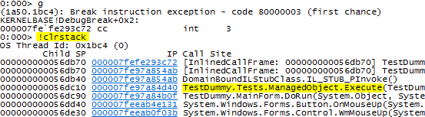
M1: Objects – Call Stack
Run WinDbg, open CrashLab.exe, press F5 and execute the Module 1: Create Managed Objects test.
Load sos
Examine the CLR call stack:
Some CrashLab tests invoke DebugBreak(), giving control back to WinDbg. Note that when run without a debugger, this will appear as if the process has crashed
Notes:
→ If you see a checksum error upon running !clrstack, rerun !clrstack.
There may be times when you want to capture your debugging session.
You can enable automatic logging to a file of your choice using the .logopen and .logclose commands:
.logopen <file-path>
.logclose

Slide 25
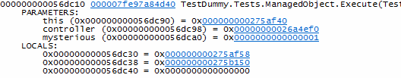
M1: Objects – Call Stack
Show the parameters and local variables of each call:
0:000> !clrstack -a
Notice the status bar while hovering over each address:
!DumpObj /d 000000000275af58
Click the links to see the results
Notes:
→ The results show the ModelA instance with all of its properties

Slide 26
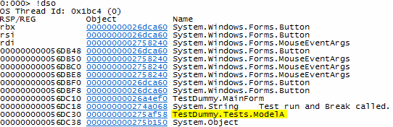
M1: Objects – Call Stack II
Use !DumpStackObjects (!dso) to display all managed objects within the bounds of the current stack, in reverse order in which they were created
0:000> !dso

Slide 27
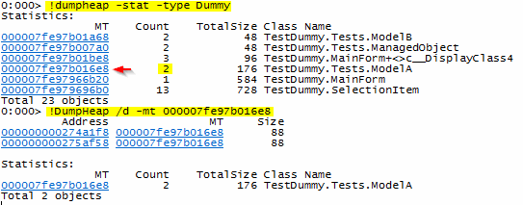
M1: Objects – Heap
Use !DumpHeap to display all managed objects
0:000> !dumpheap –stat [-type typeNameSubstr]

Slide 28
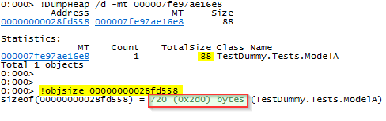
M1: Objects – Sizes
Notice the reported size of ModelA, 88 bytes
Equals the size of the direct fields of the object
Does not include the contained objects it references
!objsize sums the size of the object and children
0:000> !objsize [<addr>]

Slide 29
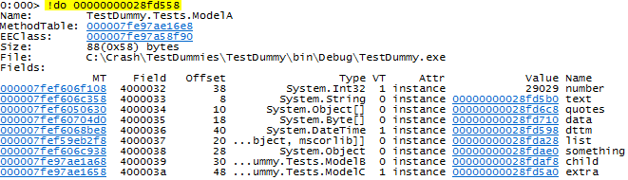
M1: Objects – Field Values
Using any of the previous methods, find an instance of the ModelA type and copy its address to the Scratch Pad window
Using its address, dump the fields of the object:
0:000> !do [<addr>]

Slide 30
M1: Objects – Field Values
The !DumpObj command is for reference types
Try dumping the dttm field:
0:000> !do 00000000028fd598
<Note: this object has an invalid CLASS field>
Invalid object
That’s because dttm is a DateTime which is a value type. Try !DumpVC instead:
0:000> !dumpvc <MTaddr> <addr>
such as:
0:000> !dumpvc 000007fef6068be8 00000000028fd598

Slide 31

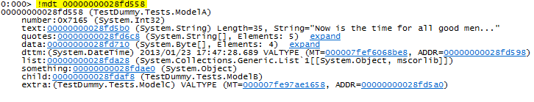
M1: Objects – A Better !do?
!mdv [frame] shows all variables on given stack frame
!mdt <addr> shows a complete picture of the object
Notes:
→ These are sosex commands

Slide 32
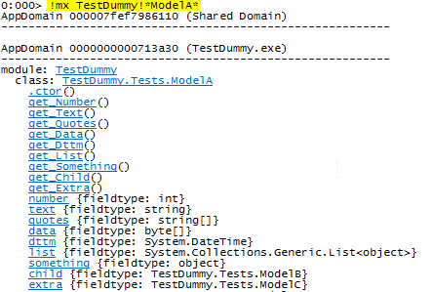
M1: Objects – Metadata
The !mx command can be used to view the type metadata of an object – the object’s class

Slide 33
Module 2: Leaks
GC Internals
How do we monitor for memory leaks?
How can we identify leaked objects?
How do we find the culprit?

Slide 34
M2: Leaks – GC Modes
Workstation Mode
AppDomain
Server Mode
CPU1
Small Object Heap
CPU 1
CPU 2
Small Object Heap
Small Object Heap
Ephemeral Seg
Segment 2
Segment X
Large Object Heap
Large Object Heap
Large Object Heap
Segment 1
Segment X
Notes:
Workstation mode is additionally broken down into concurrent and non-concurrent modes.
Concurrent workstation mode is for multi-CPU workstations; EE is suspended much shorter but several times during GC
Non-concurrent workstation mode is for single-CPU workstations; EE is suspended during GC
Modes can be configured via the application config file with one of these entries:
<gcConcurrent enabled=“true” />
<gcConcurrent enabled=“false” />
<gcServer enabled=“true” />

Slide 35
M2: Leaks – GC Modes
In Workstation mode, objects are finalized on the thread that creates them
In Server mode, there is a dedicated finalizer thread for all GC activity
Heaps are allocated and extended one segment at a time
Segments are generally 16MB but may differ between Workstation and Server

Slide 36
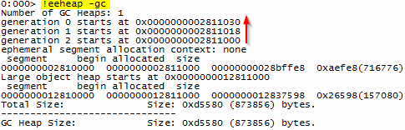
M2: Leaks – Follow the bouncing…
Open WinDbg and startup CrashLab.exe
Run Module 1: Generation Tracking
This test forces a breakpoint. Enter !eeheap -gc
Note address of relative order of gens (2-1-0-LOH)
They are contiguous so we can calculate sizes

Slide 37
M2: Leaks – Follow the bouncing…
Find the address of the ModelA instance
In which generation does it reside? Try !gcwhere
0:000> !gcwhere <addr>
Go until Break is hit again. Where is ModelA now?
What happened?
Notes:
After the first allocation, a GC.Collect() is invoked. Our ModelA instance survives this pass and is promoted from Gen0 to Gen1; the GC moves (copies) the object data from the Gen0 segment into the Gen1 segment. This is why its address changes.

Slide 38
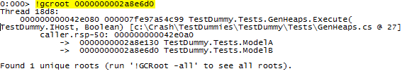
M2: Leaks – Roots
Every “live” object is rooted by another.
The !groot command is used to trace roots. Use this command to find the root of the ModelB class.
0:000> !gcroot <addr>
In your spare time: take a look at the !vgcroot command. This generates a DGML output file that can be visualized by Visual Studio
Notes:
If debugging .NET 4.0 using PSSCOR4, try the !gcusage command.
Unfortunately, for .NET 4.5, this command is unavailable until a new compatible version of PSSCOR is released.

Slide 39
M2: Leaks – Lay of the Land
When tracing memory leaks, first understand the boundaries
0:000> !eeheap -gc 0:000> !eeheap –loader 0:000> !address -summary 0:000> !dumpheap –stat 0:000> !dumpgen –stat [0|1|2]
If anything stands out, investigate!
0:000> !dumpheap –stat –type <MyTypeName> 0:000> !gcroot <addr> ...
If not apparent, let the system continue to run and, sometime later, take another snapshot to compare against the first

Slide 40

M2: Leaks – WAKE UP!
LAB
The lab begins on the next slide but before that…
Learn about the ~*e!clrstack command
Learn about the !clrstack –i command
Ready? Go!
Notes:
The ~*e!clrstack command is actually a compound command with these parts:
~ is the “show all native threads” command
* is an operator that means “for each”, e.g., for each native thread…
e is the “evaluate” command
!clrstack is the command to evaluate for each native thread.

Slide 41
M2: Leaks – Lab
Start CrashLab.exe
Start PerfMon
Click the green + to add counters
Select the .NET Memory category, the CrashLab instance, press Add>>
Counters for the instance are displayed and monitoring begins
Find the “Gen 0 Heap size” counter. Does it have a value?
Run the CrashLab GC.Collect test. Do you see a value now?
Run the Leaked: Managed test (Mystery 2), accept the defaults.
Watch the PerfMon counters. What’s happening?
Watch for a few minutes. What do you notice?
(Are we having fun yet? … What happens if we run the GC.Collect test while the Leaked: Managed test is executing?)
Notes:
Symptoms of Memory Leaks
Unmanaged: Private Bytes increases while #Bytes in all heaps remains flat
Managed: Private Bytes and #Bytes in all heaps both increase

Slide 42
M2: Leaks – Lab
Run WinDbg and attach to the CrashLab process
The injected breakpoint is hit and WinDbg awaits your input
The memory allocations are going through the roof!
What’s the first command we should enter?
Wait for it…

Slide 43
M2: Leaks – Lab
Run WinDbg and attach to the CrashLab process
The injected breakpoint is hit and WinDbg awaits your input
The memory allocations are going through the roof!
What’s the first command we should enter?
For memory problems, first take a look at the heap
0:000> !dumpheap –stat
Of course there are many ways to attack each problem
!clrusage (PSSCOR) may also provide useful information

Slide 44
M2: Leaks – Lab
Are there any objects with surprisingly high Count or TotalSize?
If the count is very high, listing all instances may take a very, very long time (!dumpheap –mt <mtaddr>)
Instead, look at the CLR stacks. Is it obvious which stack may be creating these objects?
Dump the CLR stacks for all threads
0:000> ~*e!clrstack
Using the !threads command we can see there are multiple threads and one is a ThreadPool worker thread
What’s the name of the top CrashLab function?

Slide 45
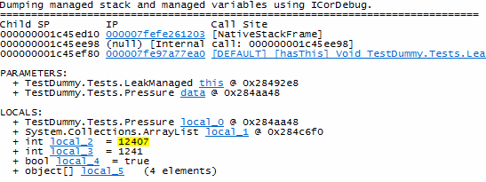
M2: Leaks – Lab
The -i parameter of !clrstack provides plenty of information
0:000> !clrstack 0:000> !clrstack -a 0:000> !clrstack –i ← hover over the CrashLab method shown with this command 0:000> !clrstack –i –a 1
Looks like we have a winner!
Finally, investigate and fix the source code of this method

Slide 46
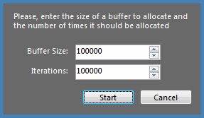
M2: Leaks – Extra Credit
Rerun this lab and alter the default run parameters as shown here:
What’s different?
Hint: !eeheap -gc

Slide 47
Module 3: Hangs
How do we attach to a hung process?
Which thread is hung (or threads)?
Which bit of code is hanging?
Why is it hanging?

Slide 48
M3: Hangs
A process may hang because of
High CPU – Process is non-responsive and consumes high CPU continuously or for a noticeable period of time
On a multi-CPU or multi-core system, will most likely be restricted to one CPU or core depending on design
Low CPU – Process stops responding but the CPU utilization of the process is 0 or very low
Can affect the UI thread or appear that a consumer is waiting for resources
Could be a deadlock where two or more threads are waiting for the same or conflicting resources

Slide 49
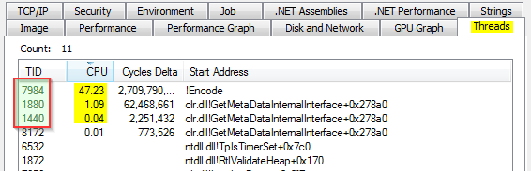
M3: Hangs – High CPU
Run CrashLab.exe
Use Process Explorer to monitor CPU activity for the CrashLab process. (Right-click, Properties, Threads tab)
Run the Hang: High CPU test (Mystery 5) and choose “Run in the background”. Click Start.
Using Process Explorer, view the thread statistics to find which thread is consuming the most CPU (write down the thread ID)

Slide 50
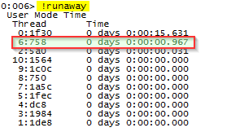
M3: Hangs – High CPU
The !runaway command display information about the time consumed by each thread
How does this report compare to the real-time view in Process Explorer?

Slide 51

M3: Hangs – High CPU
While the test is running, create a dump file:
From Process Explorer, right-click the process and choose “Create Dump… Create Full Dump”
Stop the test or end the process
Run WinDbg and open the dump file
Convert the thread ID to hex:
0:000> ? 0n7984 Evaluate expression: 7984 = 00000000`00001f30
Notes:
You can use the .dump command from within WinDbg to generate a dmp file for the current process.
Typically use either
.dump /ma or
.dump /mf
There are many more /m options available for the .dump command; check the help (0:000> .hh .dump)

Slide 52
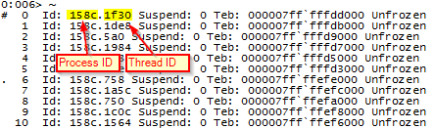
M3: Hangs – High CPU
View native threads using the ~ command
Switch to the native thread and view its call stack
0:000> ~6s 0:006> k
Also view its managed stack with !clrstack
Notes:
The first column is the logical thread ID assigned by the debugger
The Id column shows the hex process ID followed by the hex thread ID
The Teb column is the starting address of the Thread Environment block

Slide 53
M3: Hangs – High CPU
Assume we don’t have access to the source code!
Look at the managed stack to determine the function that is likely causing the high CPU hang
How do we determine its assembly module?
Once we do, use the lm command to determine the starting address of the module
Save the module to a disk file
0:006> !savemodule 000000013f700000 C:\crash\ExportedModule.dll
Now we can load the file into Reflector to view the C# code and investigate why it might be consuming CPU! Pretty cool, huh?

Slide 54
M3: Hangs – WAKE UP!
LAB
The lab begins on the next slide…
We’ll learn about
Sync Blocks
Native Handles
Simple Deadlocks
Ready? Go!

Slide 55
M3: Hangs – Lab
Run CrashLab.exe
Run the Hang: Deadlock (Mystery 4) test
Choose the defaults and click Start
What happens?
Run Process Explorer
Is the UI responsive?
Is it using CPU?
In Process Explorer, look at the thread call stacks
What is the top-most function in every thread?
Hm. If only we had an advanced debugger…

Slide 56
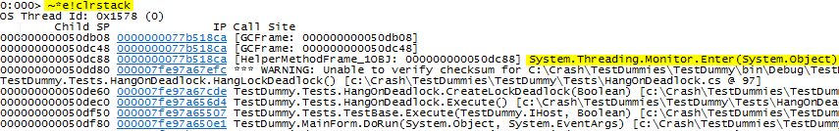
M3: Hangs – Lab
Run WinDbg and attach to the process
For all native threads, evaluate !clrstack
0:008> ~*e!clrstack
Notice that two threads are in the same function
Remember that the C# lock statement is implemented as a Monitor

Slide 57
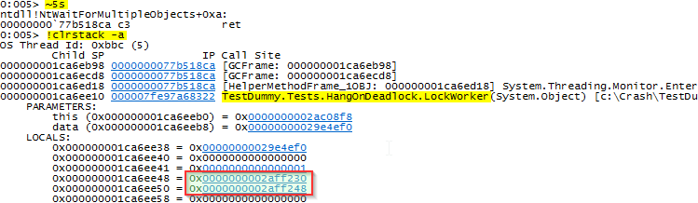
M3: Hangs – Lab
Take a closer look at one of these threads
The LockWorker function has a few local variables
There are two of particular interest
Use the !do command to examine these objects

Slide 58

M3: Hangs – Lab
We can see that they are both DatabaseWriters
Examine the other thread. Is it similar?
What are the addresses of the objects?
Two threads waiting on Monitors using the same DatabaseWriter instances… sounds like a deadlock
Let’s prove it further…

Slide 59
M3: Hangs – Lab
Every managed object is prefaced with an object header of four bytes (at <addr>-0x04)
If the header is “full” the CLR uses “header inflation”
A sync block table entry is allocated
The table entry index is stored in the object header
The high-order byte is set to 0x08
This object has a sync block index of 0x002e
Object Header
0x0800002e
Object Data
Notes:
When using the C# lock statement on an object,
the lock information is stored as part of the object as either
a “thin lock” or
a sync table block index

Slide 60

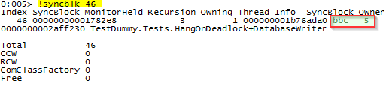
M3: Hangs – Lab
Examine the header of the first DatabaseWriter
The sync block index is 0x02e (46)
The Thread Info is thread 0xbbc (#5)
The current thread owns this since it was a local variable to a function on this thread’s stack!

Slide 61
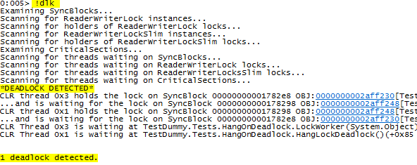
M3: Hangs – Lab
Now the “why-didn’t-you-say-that-first” command:
Clearly, we need to refactor the LockWorker and HangLockDeadlock methods to avoid this!

Slide 62
Module 4: Finalizers
What could possibly go wrong?
How do we examine the finalization queue and the fReachable queue?
What objects are acting suspiciously?
Why? Can you fix it?

Slide 63
M4: Finalizers – Review
Recall from PSR Workshop Part 1 that the CLR maintains two queues for finalizable objects
Finalization queue references all live objects with finalizers
fReachable queue references all unrooted objects with finalizers ready to be run
The Finalize thread dequeues objects from fReachable and executes each object’s Finalize method
Why might an object appear to be “stuck” on the finalization queue?
While we may think we’ve de-referenced a finalizable object, it may still be rooted elsewhere. This is a basic leak.
Or…

Slide 64
M4: Finalizers – WAKE UP!
LAB
The lab begins on the next slide…
We’ll learn about
Examine the Finalization queue
Examine the fReachable queue
Detecting hung finalizers
Ready? Go!

Slide 65
M4: Finalizers – Lab
Run CrashLab.exe
Execute the Finalizer: Blocked (Mystery 9) test
This test creates Mortal instances which are finalizable
Background or UI thread – doesn’t matter
Wait for the message “Test completed”
Attach WinDbg to the CrashLab process
Examine the heap with !dumpheap –stat –type Dummy
How many Mortal instances are there on the heap?
Are they alive?
Let’s check…

Slide 66

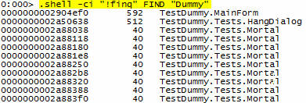
M4: Finalizers – Lab
Is there anything in the fReachable queue?
OK, they must be in the Finalization queue
Try the !fq command too

Slide 67
M4: Finalizers – Lab
Force a garbage collection
Use the g command to continue execution
Run the GC.Collect() test
In WinDbg, press Ctrl-Break
Check the fReachable queue
Check the Finalization queue
Compare !fq now with the previous !fq output
What happened?
How many are in each queue?

Slide 68
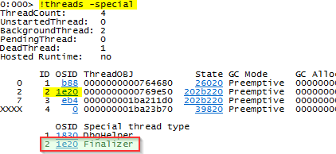
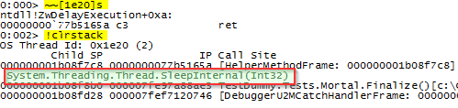
M4: Finalizers – Lab
Examine the Finalizer thread
What’s it doing?

Slide 69
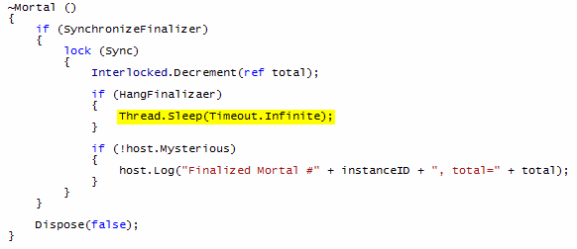
M4: Finalizers – Lab
Take a look at the Mortal finalizer
Do you think there’s a problem?

Slide 70
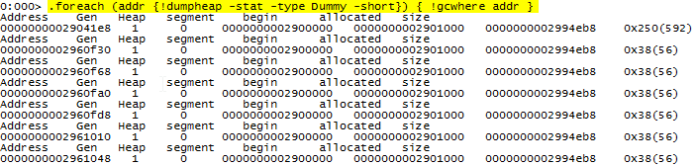
M4: Finalizers – Lab
One more, just for fun
WinDbg has a rich (if not slightly cryptic) scripting language

Slide 71
M4: Finalizers – Gentle Reminder
Only implement a finalizer if your class has direct references to native memory, e.g. via Interop
Follow the full IDisposable pattern as discussed in the PSR Workshop Part 1 presentation – The .NET Garbage Collector and Best Practices
Suppress finalization from the Dispose() method
Finalizers should not interact with managed objects
Finalizers are meant to release native references
Never raise exceptions from a finalizer
Keep finalizer code paths short and simple

Slide 72
M4: Finalizers – On your own time!
Compare these two tests
Finalizer: Suppressed (Mystery 7)
Finalizer: Unsupressed (Mystery 8)
Once the object is disposed you should notice
The GC only needs one pass to eliminate an object when its finalizer is supressed
The GC needs two passes to eliminate an object because it needs to move it from the Finalize queue to the fReachable queue where it waits for the Finalize thread; this thread is resumed on the next pass

Slide 73
Module 5: Exceptions
How do we identify exceptions?
How do we trace the originator?
What is the exception?

Slide 74

M5: Exceptions – What are the chances?
Build an Exception Info Table for each executable
Populate Exception, run finally block, resume execution
Yes
Handler?
Exception Occurs!
No
Start of call stack?
Search table for handler in previous method
No
Create an Exception object
Yes
Notify debugger 1st Chance
Populate Exception, execute finally block
Search table for handler in current method
Unhandled Exception
Notify debugger 2nd Chance
Terminate process
Notes:
Debuggers can register for either or both 1st chance or 2nd chance notifications.
For example, ADPlus has command line parameters that let you specify one or both of these notifications to automate crash dumps.

Slide 75
M5: Exceptions – WAKE UP!
LAB
The lab begins on the next slide…
We’ll learn about
The !PrintException command
The !StopOnException command
Take this time to investigate the sx related commands
Ready? Go!

Slide 76
M5: Exceptions – Lab
Run CrashLab.exe and run the test Module 5: Raise Managed Exception
Run WinDbg and attach to the CrashLab process
Switch to thread 0 using ~0s
Dump the CLR stack. Which method raised the exception?
Dump stack objects. Which exception was raised?
Dump the exception object. What is the message?
Using the address of the exception, try !PrintException (!pe)
0:000> !pe 0000000002a06030
Now continue execution (F5) and run the test again. Does it break and release control to WinDbg?

Slide 77

M5: Exceptions – Lab
Do not close the Windows exception dialog.
Break into the process from WinDbg (Ctrl-Break)
What is the current thread ID?
Dump the native stack with the k command
What is the purpose of this thread?

Slide 78
M5: Exceptions – Lab
Force WinDbg to break when an exception occurs using the !StopOnException (!soe) command
0:000> !soe –create System.IO.DirectoryNotFoundException 1 0:000> g
Run the test again. Is control released to WinDbg now?
Notice the thread ID
Print the exception: can you explain the stack trace?
Continue execution, it should break immediately
Print the exception again. Does it look different?

Slide 79
M5: Exceptions – Lab
Dump the exception again using the !pe command
Notice the IP address. This points to the function
Use !threads to dump the managed threads
Notice that the exception is listed at the end of thread 0
If .prefer_dml is enabled, a link is provided to print the exception
Try the exercise on the previous slide, this time breaking on Crashlab.Test.RandomAccessException instead. What’s different?

Slide 80
M5: Exceptions – Trivia
sxe clr will break on all managed exceptions
Can be annoying! Look at the help and learn about related sx commands
Can be used to find “non-fatal” exceptions
When dealing with many threads, use this method
Dump all CLR threads. How many are there?
Use ~*e!clrstack to view all managed thread stacks. Which thread appears to be responsible for the exception?
Three exception are always loaded immediately by the process
System.ExecutionEngineException
System.StackOverflowException
System.OutOfMemoryException
Any idea why?
Notes:
sx command modifiers:
sxe – enable
sxd – disable
sxi – ignore
sxn – notify
There are also predefined “types” or “categories” of events:
sxe ld – break when a module loads
sxn av – notify (don’t break) on access violations
Also take a look at the !dae command from PSSCOR that displays all managed exceptions in the GC heaps.

Slide 81
Tools

Slide 82
ADPlus
Can be used in “production” environments to capture dump files for either hanging processes or when an exception occurs within one or more processes
Located in same directory as windbg.exe
Runs in two modes
adplus -hang – attaches, dumps, detaches
adplus -crash – attaches, waits for exception, dumps
Full documentation in adplus.doc
Example
adplus –crash –pn CrashLab.exe –o c:\dumps

Slide 83
SetCrash.bat
Included in the Lab materials
Script to enable/disable automatic crash dump creation whenever a process crashes
DumpFolder = C:\Crash
DumpType = 2 (Full dump)
http://msdn.microsoft.com/en-us/library/windows/desktop/bb787181(v=vs.85).aspx

Slide 84
WinDbg Customization

Slide 85
Workspaces and Themes
A workspace, usually associated with an executable, provides layout, colors, and some settings.
There are few predefined workspaces in the Debuggers\x64\Themes directory provided by Microsoft.
Or you can create your own and amaze your friends!

Slide 86
Workspaces and Themes
Start WinDbg
Open an executable (just to activate the whole WinDbg UI!)
Optionally, open an existing workspace as a starting point
Customize the layout, colors, etc
Remove the executable from the workspace
File… Clear Workspace…
Remove the item named “Unicode executable command line”
This is to avoid loading that exe every time debugger is started! Unless of course you want a custom workspace for that exe.
Save the workspace to a file
Note, some window settings will be saved such as the file associated with the Scratch Pad window.

Slide 87
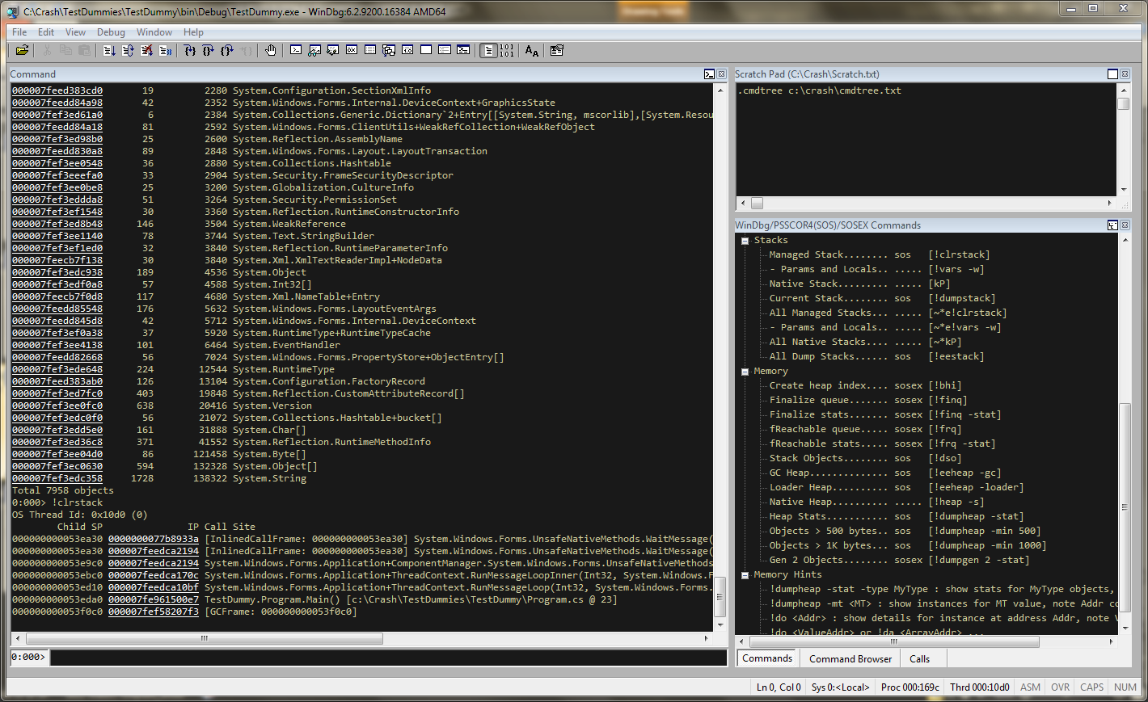
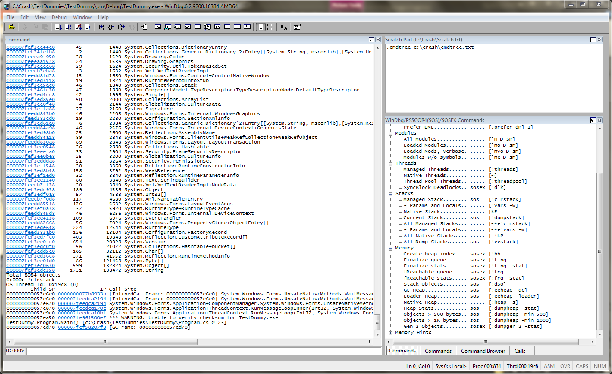
Workspaces and Themes
There are two pre-defined workspaces available in the lab materials. Both provide the same layout but different color themes.
Dark.wew Light.wew

Slide 88
Workspaces and Themes
To load a workspace from the command line:
C:\> “<path>\windbg.exe“ -Q -WF "C:\Crash\Dark.wew“
This command line can be associated with a Windows shortcut. Just double-click the shortcut and debug…
These workspaces include
WinDbg window positioning and size
Font, color, and layout of Command, Scratch Pad, and Commands
Scratch Pad window associated with C:\Crash\Scratch.txt

Slide 89
We’re Done!
Relax. Take a breath…

Slide 90

Questions/Discussion

Slide 91
Resources
If broken it is… – Tess Ferrandez http://blogs.msdn.com/b/tess/
Debugging Toolbox – Roberto Farah http://blogs.msdn.com/b/debuggingtoolbox/
John Robbins Blog – John Robbins http://www.wintellect.com/cs/blogs/jrobbins
Mark Russinovich’s Blog – Mark Russinovich http://blogs.technet.com/b/markrussinovich
The Old New Thing – Raymond Chen http://blogs.msdn.com/b/oldnewthing
How the CLR Creates Runtime Objects http://msdn.microsoft.com/en-us/magazine/cc163791.aspx

